Slide 1




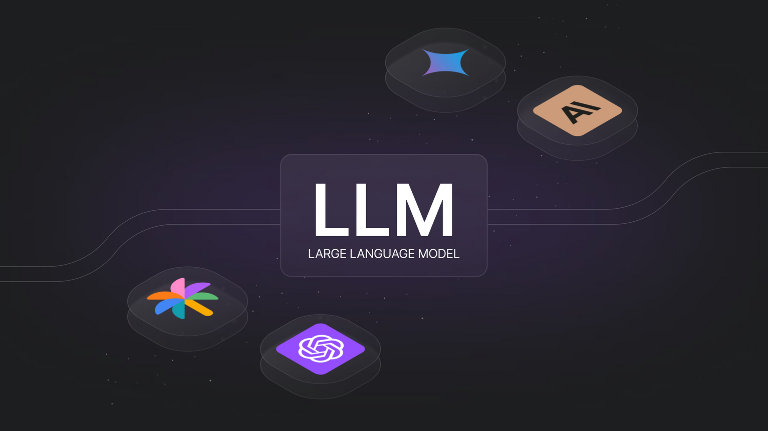

MoSA
Mixture-of-Search-Agents
Multi-LLM Collaborative Search for Complex Problem Solving
Group 4
CSI 5170 Machine Learning
Prof: Sunny Raj
By:
Jaeson Booker
Madhusudhan Swargam

Slide 2
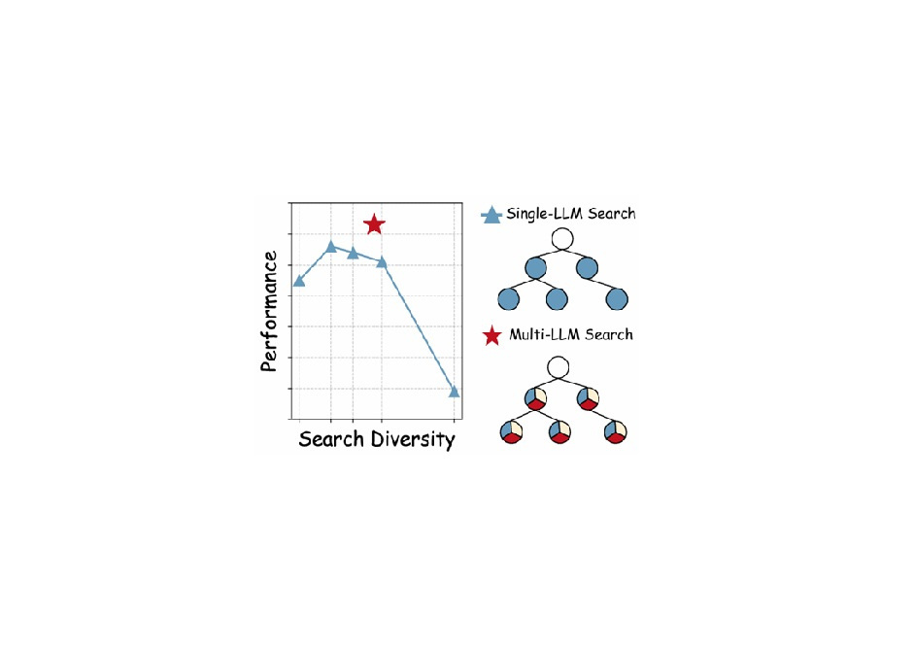


Introduction
Large language models (LLMs) often struggle with complex reasoning tasks due to their limitations in addressing the vast reasoning space and inherent ambiguities of natural language. We propose the Mixture-of-Search-Agents (MOSA) paradigm, a novel approach leveraging the collective expertise of multiple LLMs to enhance search-based reasoning.

Slide 3
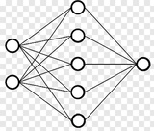

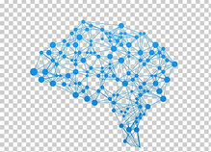

LLM -
Large Language Models
A large language model (LLM) is a type of machine learning model designed for natural language processing tasks such as language generation. LLMs are language models with many parameters, and are trained with self-supervised learning on a vast amount of text.
Large language models (LLMs) are deep learning algorithms
Recognize, summarize, translate, predict, and generate content using very large datasets
The largest and most capable LLMs are generative pretrained transformers (GPTs). Modern models can be fine-tuned for specific tasks

Slide 4

LLM Working
Encoders
Decoders
Pre Training
-> Tokenization
->Token embeddings
->Byte pair encoding
->Masking
->generating the next word token
Fine-tuning

Slide 5
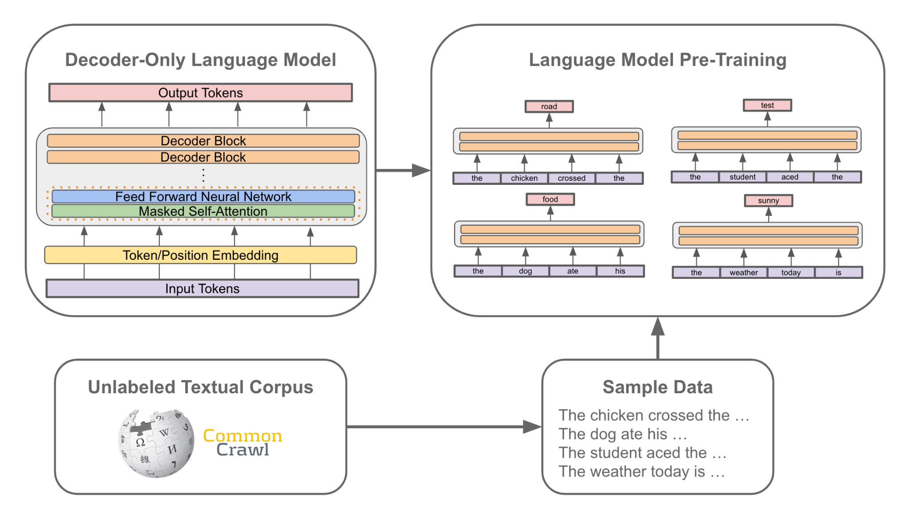

Slide 6
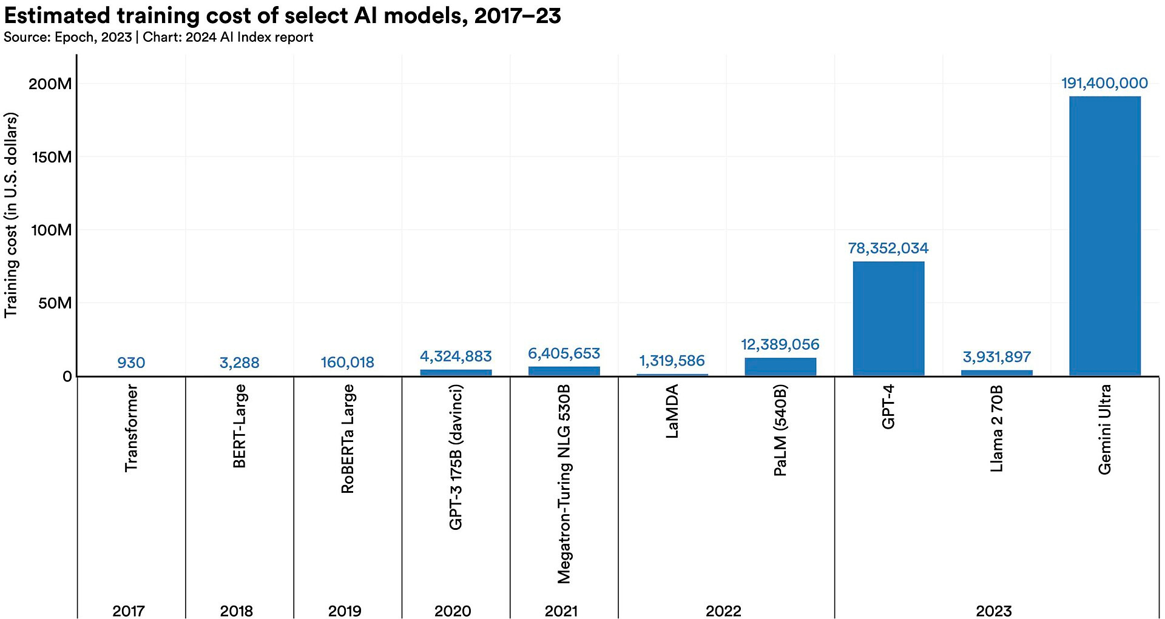
Training cost

Slide 7

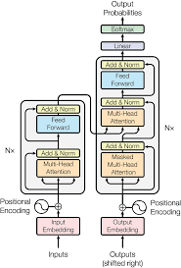
LLMs Used
llama-3.1-8b-instruct
The Meta Llama 3.1 is generative models in 8B, 70B and 405B sizes
qwen-2-7b-instruct
Qwen2 base language models and instruction-tuned language models ranging from 0.5 to 72 billion parameters, including a Mixture-of-Experts mode
mistral-8b-instruct
state-of-the-art models for local intelligence, on-device computing, and at-the-edge use cases
glm-4-9b-chat
GLM-4-32B-Base-0414 was pre-trained on 15T of high-quality data, including substantial reasoning-type synthetic data.

Slide 8
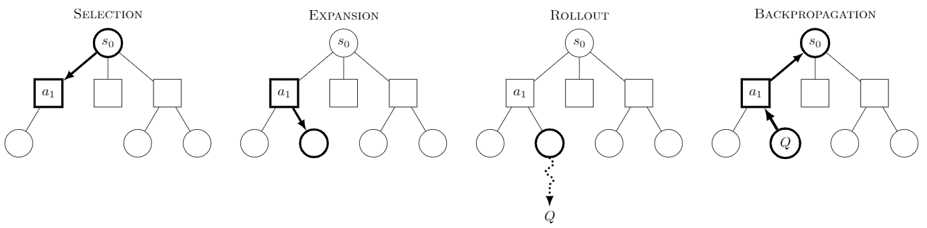
Monte Carlo Tree Search (MCTS)
Selection
Expansion
RollOut
BackPropagation

Slide 9
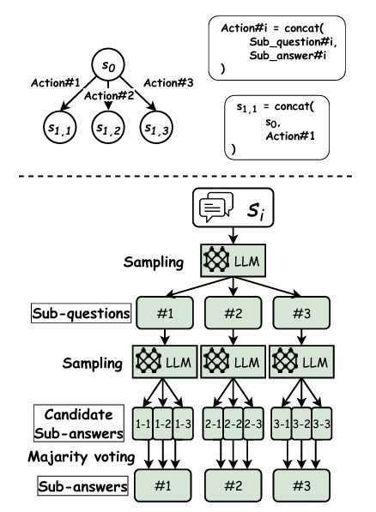

Algorithm
Sub Questions
Sub answers

Slide 10
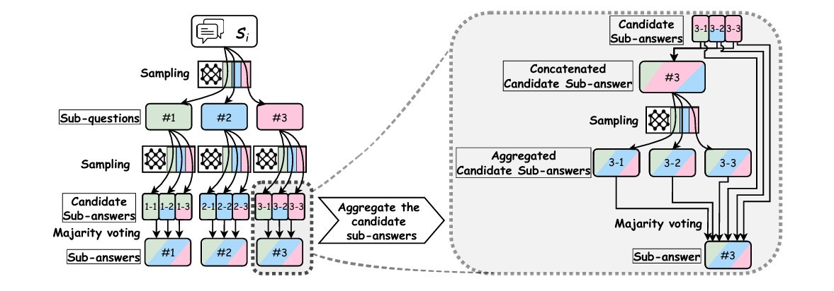
Algorithm

Slide 11
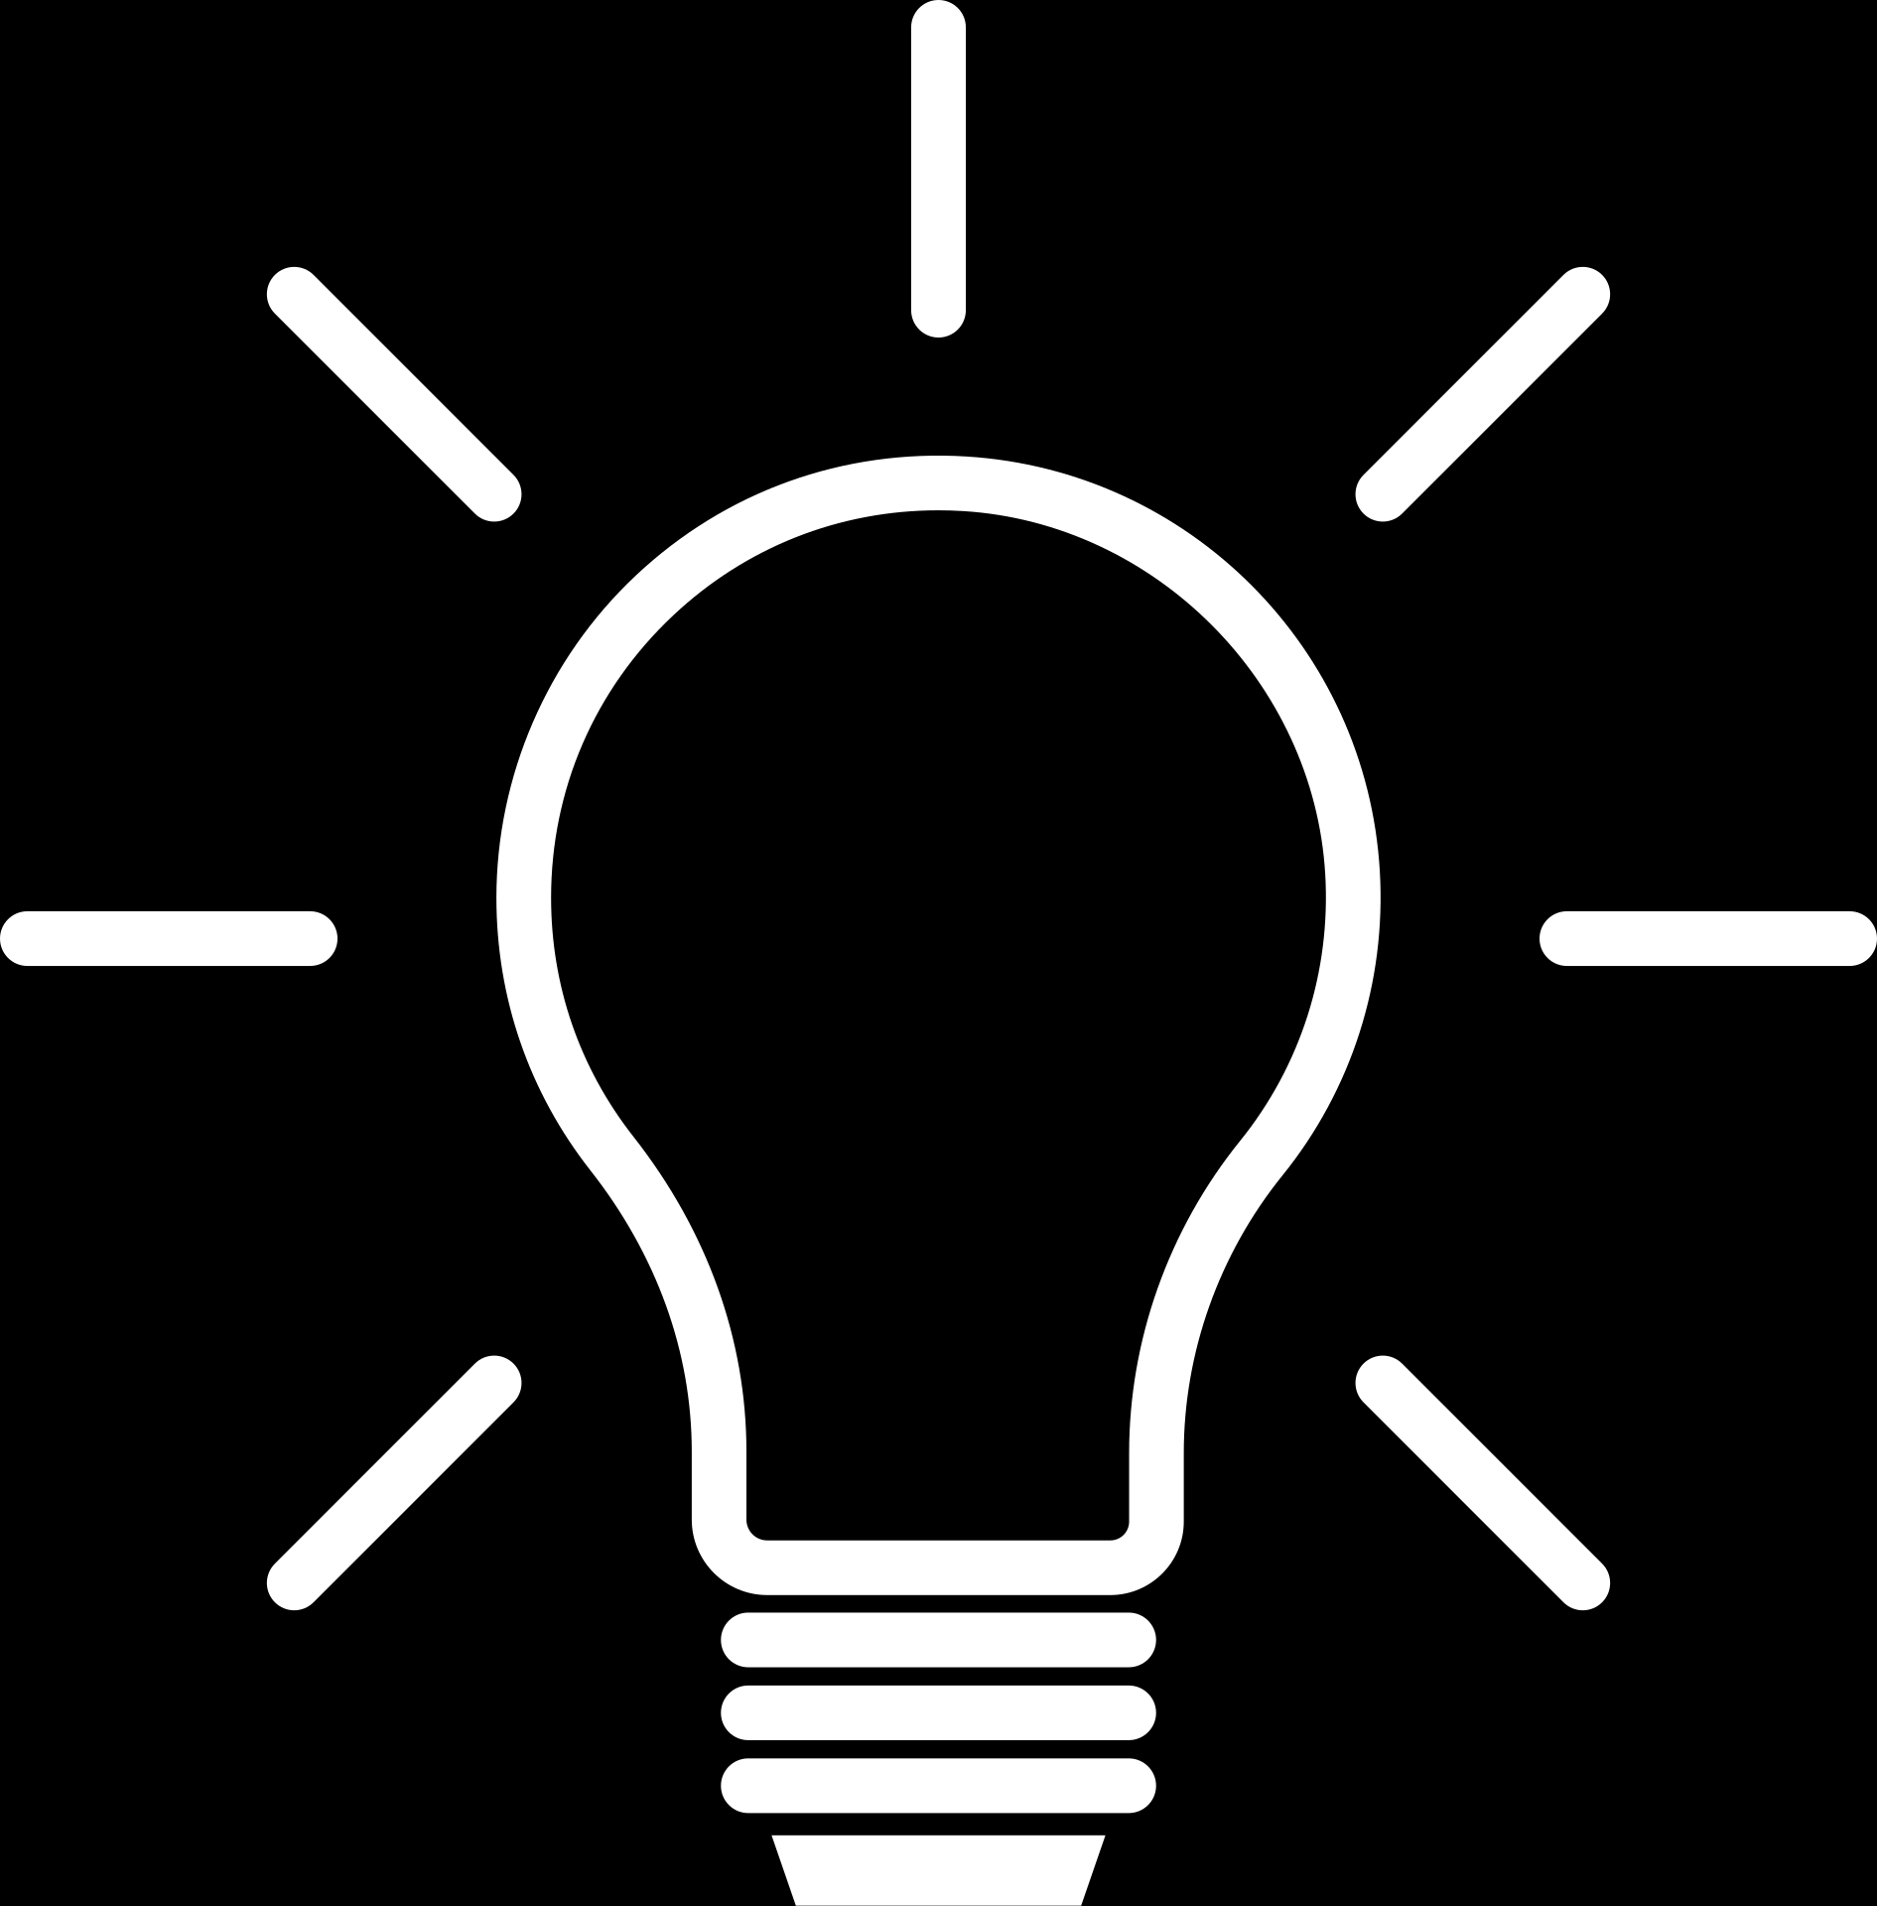
Work Results MATH500
what is the lowest common multiple of 6, 10 and 15.
Aggregated(The least common multiple (LCM) of 6, 10, and 15 is 30.)
Calculate the time from 10:55am to 3:05pm.
How many hours are between 10:55am and 3:05pm? Aggregated(The difference is 4 hours and 90 minutes. (In hours only: 4 hours))

Slide 12
Work Results: STRATEGYQA
Do alpine skiers use a technique named for a vehicle?
" S ki ers use the ' P or sche ' technique ."
Is Monday the enemy of a cat?
No logical connection exists between Monday and a cat's well-being.

Slide 13
Work Results
. The Results from the paper for
MATH - 56.64
STRATEGYQA – 76.42
. The Results from the Team work for
MATH - 50
STRATEGYQA – 76.4
Calculate the time from 10:55am to 3:05pm.

Slide 14
Conclusion
Similarity score to paper results : MATH - 88%
STRATEGYQA – 99%

Slide 15
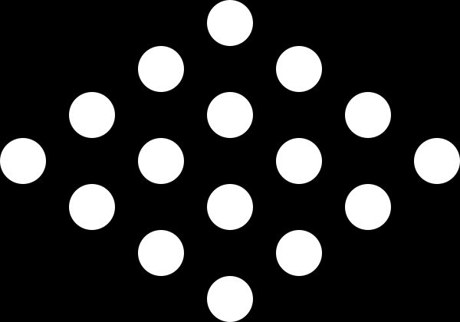

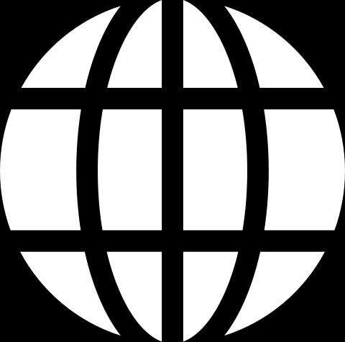
THANK YOU!

